Slide 1

Team Members-
Anirudha Agarwal (20BCE1738)
Siddharth Thakur (20BCE1144)
Prakul Vyas (20BCE1273)
Abstract
Designing and developing a product/service for solving real world problem which is economically feasible.

Slide 2
Introduction
When you think of the very first car, what do you imagine? While some of the very first cars were powered by steam engines, dating back to the 1700s, The first cars didn’t have windshields, doors, turn signals, or even a round steering wheel – a far cry from what we’ve become accustomed to. In the late 80’s and early 90’s keyless entry systems, electric doors and windows, sunroofs and CD players began to be standard features. This is about the time when technology became a big selling point. This brings us to modern-day cars with Bluetooth, hard drives, advanced safety systems, GPS, WiFi and even the ability to parallel park themselves.
There has been drastic advancement in the car technology but there is very little improvement in the car buying process which involves car dealerships with no/little advancement in technology, complex taxation and rules, salesmen giving biased opinion about the cars of their employer’s company, confusion, spending much more time and money than needed in deciding which car and variant to buy. To overcome the above mentioned problems we have come up with an idea i.e CarAdvisors.

Slide 3
Customer Requirement and Statements
I want the best car available in the car according to my needs and budget,
I want to test drive cars, these online sites do not offer that.
The process of selecting and buying the car is a tedious task.
I want an unbiased opinion of an expert during whole process.
I bought the wrong car because of wrong advice.
I was not told of long term cost of the car and now I am not able to bear the cost.
Same features were offered in much cheaper car than the car I own but I didn’t knew that at the time of buying the vehicle.
These salesmen just show their company’s car as superior to their competitors.
They don’t tell the real difference between the other cars available in the same segment and their car.
I want cars of all carmakers available under one roof and an unbiased expert opinion so that I can compare the features, cost and test drive without going to different places.

Slide 4
Problem Statement
The objective is to have offline showrooms across various cities in India and in other countries which have a good car market. In these showrooms, cars of all carmakers will be available where automobile industry experts(employees of CarAdvisors) will be advising the car buyers about the cars by giving all relevant stats and unbiased opinion.

Slide 5
Concept Generation
Brainstorming
Knowing very well the customer requirements, we henceforth sat for a brainstorming session within our group and we came up with a mind map incorporating all functions and ideas for the product. We used the idea of mind map to clearly lay down our ideas and creativities using which we can develop our concepts.

Slide 6
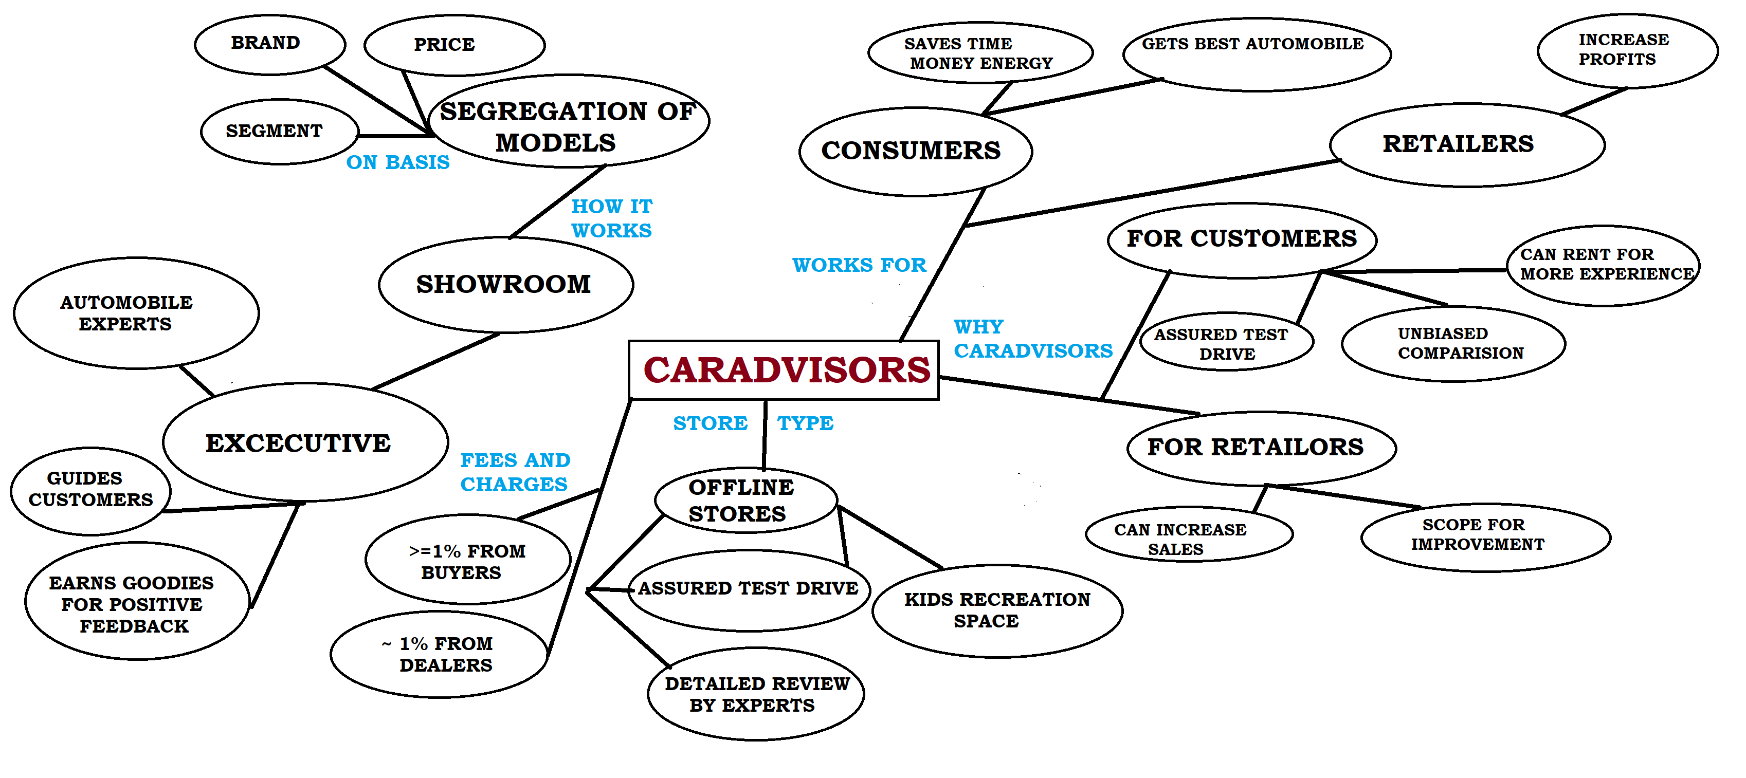
Concept Map

Slide 7
Overview
The idea is to have showrooms as multi storey buildings where we will keep all cars of all segments(hatchback, sedan, suv, mpv) available in display as they are present currently in car dealerships. But these car showrooms/dealerships only have their company’s cars in display. We will have multiple companies models for display at our showrooms where our consultants who will be automotive experts will be suggesting customers about the cars as per their needs and budget by stating facts and giving unbiased opinion about every car as they are employees of CarAdvisors unlike salesman of various company dealerships.
Also customer will be able to do test drive, get experience and information about different cars at the CarAdvisors showrooms. Even they can rent the car for few days so that they can have more insights about the car. This is done so that customers need not visit different companies dealerships to inquire about cars, it will save their time, efforts and money.
Also in showrooms we will be having much needed kids recreational area so that parents and kids both get a good experience at CarAdvisors as kids would indulge themselves in playing which will be under supervision so that parents would feel relaxed and take decisions unlike the present situation.
Cars would be segregated according to their price and segment. Customers with budget for cars less than 10 lakh will be given different services in terms of ambience and comfort than customers having budget more than 10 lakh. Also services and experience will be better for costlier car customers. The most important aspects for us will be customer feedback and satisfaction.

Slide 8
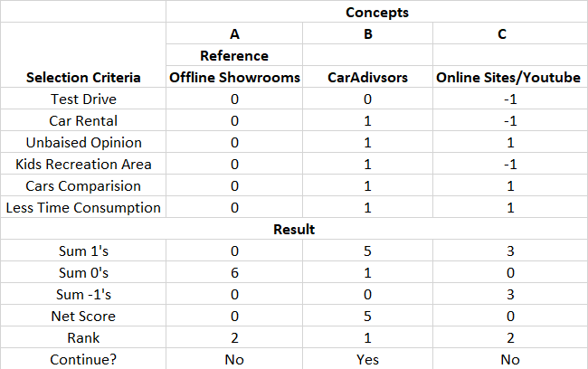
Selection Matrix

Slide 9
Identifying the vertical for business opportunity

Slide 10
All people across the world who bought a new car in the past and those who will be buying brand new cars in the future for the first time will be our potential customers i.e from the above given pie chart all customers owning the cars of different companies.
Maruti Suzuki India has a monopoly in Indian car market with 52% market share but we will have approx. double the customers as they are having now with 100% market share as there is no competition for us.
Not only in India but in countries like USA which is having much bigger car market than India also don’t have any such services available as stated by CarAdvisors. So we will cater to foreign countries car customers too and offer our services after amending them as per customer needs.

Slide 11
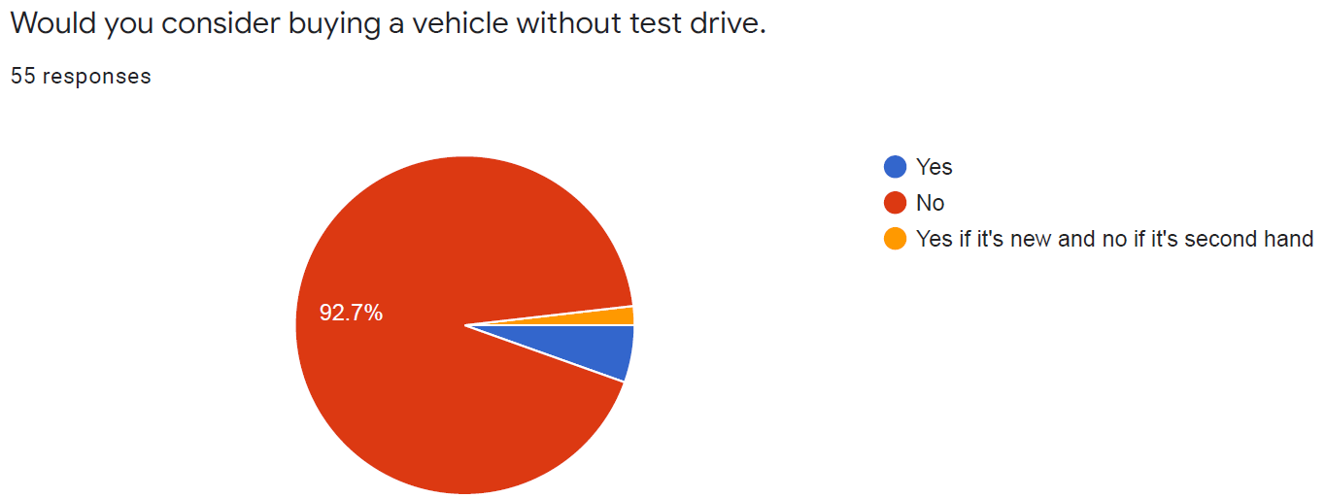
Understanding our customers
We have conducted a survey about car buying process and we got 55 responses in it and these are the responses-
In this question approximately 93 percent of people want to take test drive of a car before buying it.

Slide 12
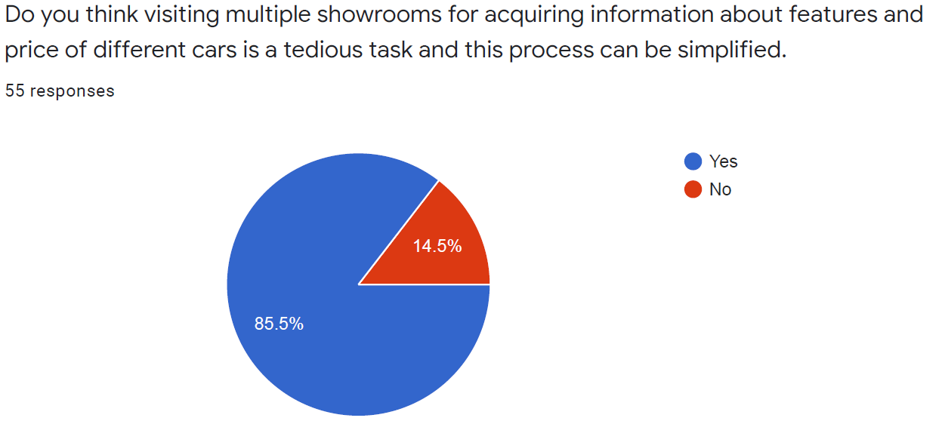
In this question approximately 85 percent of people feels difficultly in visiting different showrooms and they want an easier process.

Slide 13
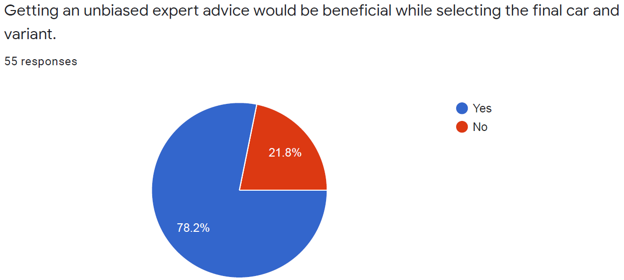
In this question 78 percent of people want unbiased expert advice for selecting their car.

Slide 14
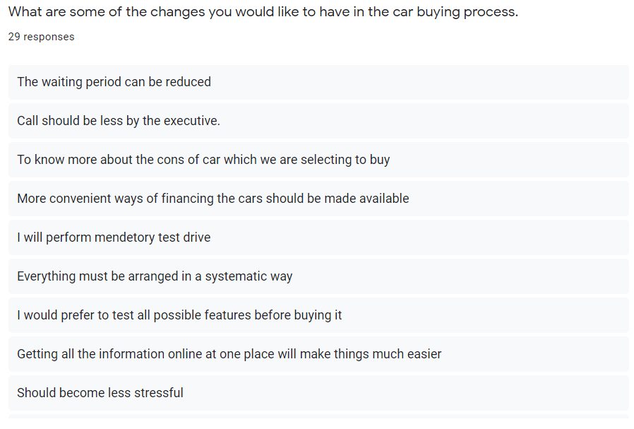

Slide 15
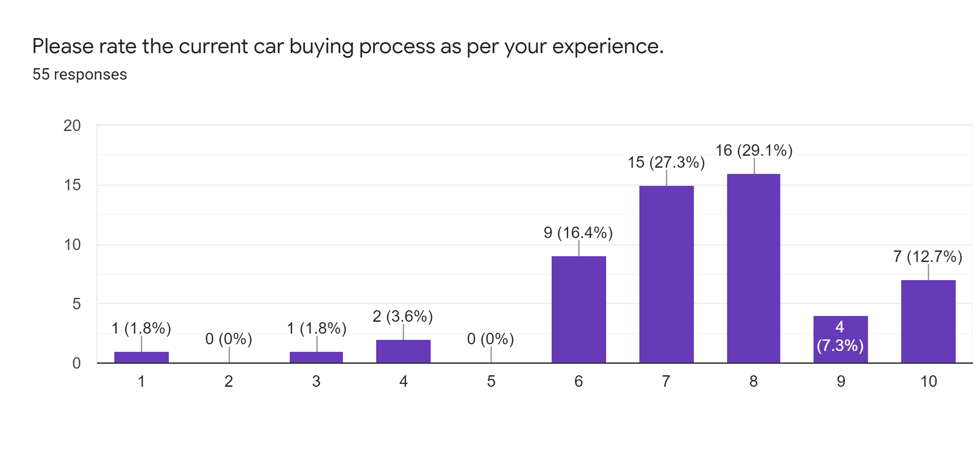

Slide 16
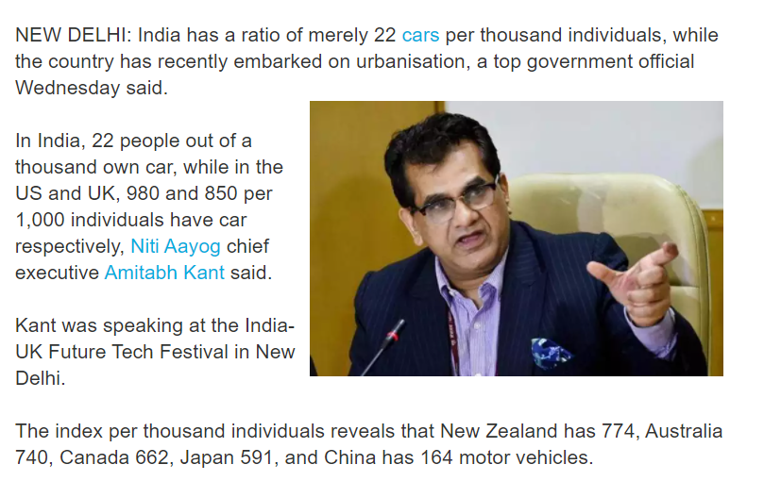
Assessing market opportunity

Slide 17
In India, 22 people out of a thousand own car, while in the US and UK, 980 and 850 per 1,000 individuals have car respectively.
The index per thousand individuals reveals that New Zealand has 774, Australia 740, Canada 662, Japan 591, and China has 164 motor vehicles.
The International Energy Agency (IEA) finding suggest that the passenger car ownership in India will grow by 775% over the next two decades with 175 cars per 1,000 people in 2040.
Early forecasts for new vehicle sales in USA this year range from about 15.6 million to 16 million vehicles, which would be an increase of between 7.6% and 10.3% compared with 2020. Last year's sales were down 14.8% to 14.5 million vehicles, according to Cox Automotive.
In year 2020 for automobile companies had their sales reduced drastically due to the pandemic, still 14.5 million new vehicles were sold. Even in the worst times there were 14.5 potential customers for us from one country(USA) as they is no competitor for us. So all over the world we have more than 25 million customers with the number increasing linearly every year by 7-10%.

Slide 18
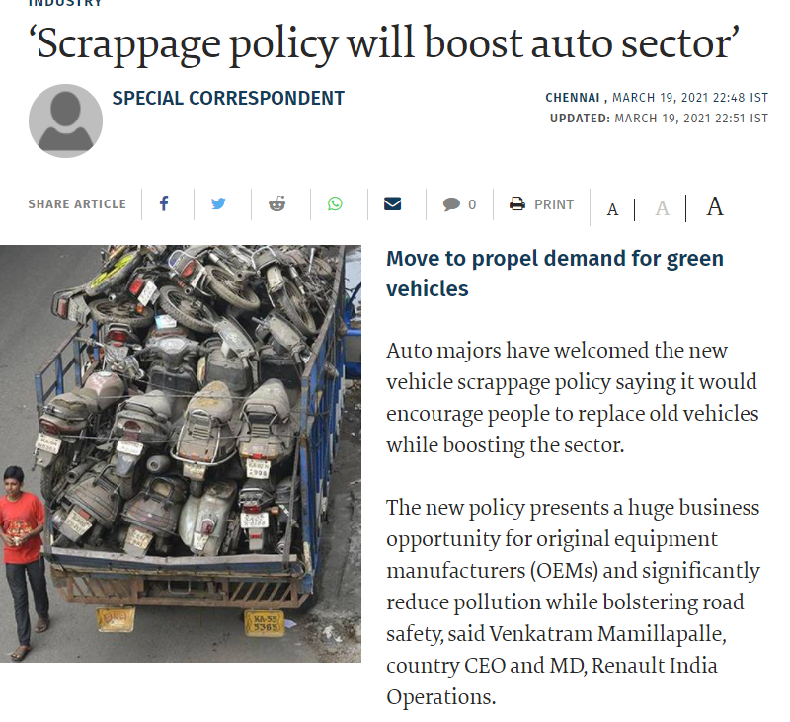
Vehicle Scrappage policy
The vehicle scrapping policy is aimed at creating an ecosystem for phasing out unfit and polluting vehicles in an environment friendly and safe manner. The policy intends to create scrapping infrastructure in the form of automated testing stations and registered vehicle scrapping facilities across the country.

Slide 19
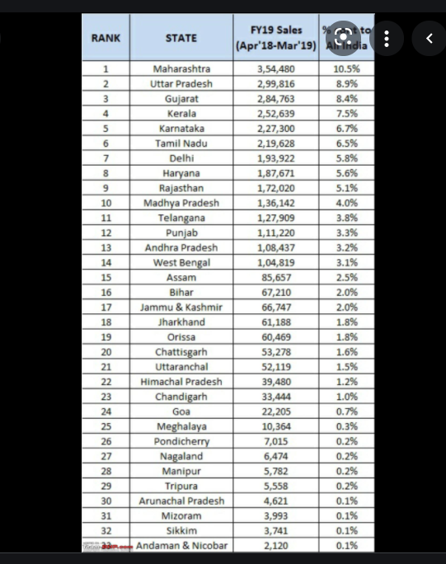
The list of cars sales in India(individual states) in year 2018-19
The information depicts the state wise annual sales of cars. Using this information we will be focusing on states according to their ranks for opening showrooms across various cities.
States with more sales will be given preference and shall be having more showrooms to get a good chunk of customers present in India.

Slide 20


Slide 21
Thank You

